Slide 1
Observing Pulsars with the Dipole Array Telescope
Brittany Wright
April 1, 2019

Slide 2
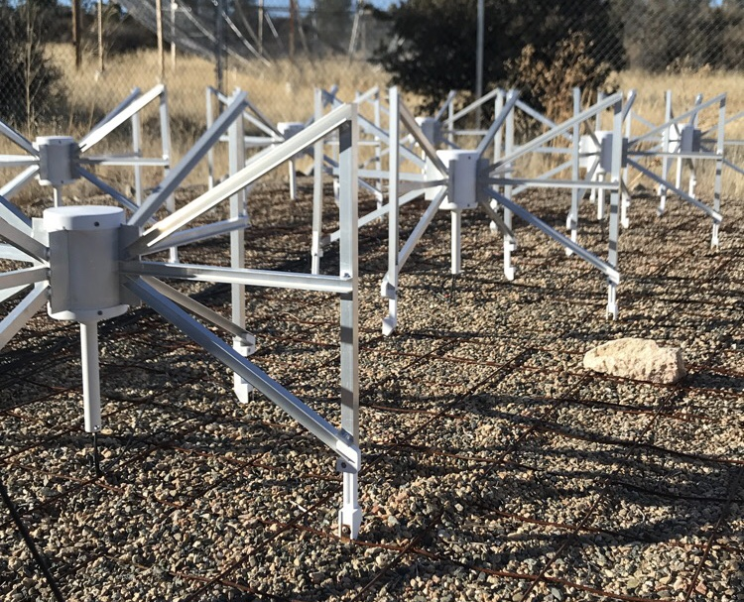
Antenna Aspects
48 Dual Polarization Antennas
100 – 300 MHz Range
Spaced at 1.1m apart
λ/2 at 138 MHz
Completely steerable above 30 degrees (with no moving parts!)

Slide 3
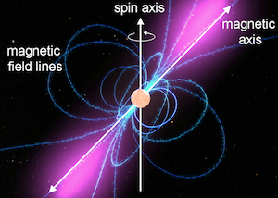
What are Pulsars?
Highly magnetized rotating neutron stars that emit radio waves at its poles
Collapsed cores of stars approximately 6 – 10 times the mass of our sun
Age and dispersion measure are determined on the number of free electrons between Earth and the pulsar
As they emit energy, their rotation frequency slows and eventually stops all together
Image Source: https://imagine.gsfc.nasa.gov/science/objects/neutron_stars1.html

Slide 4
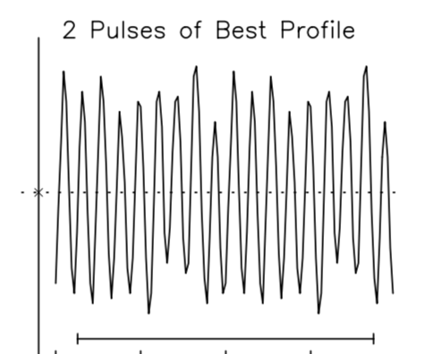
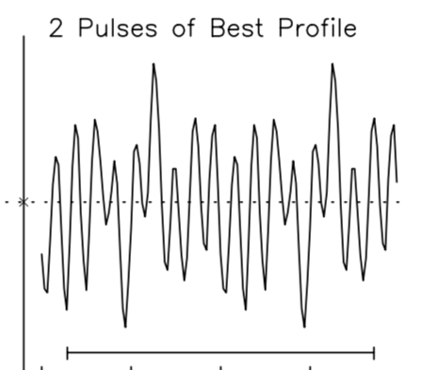
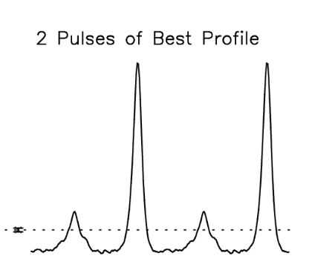
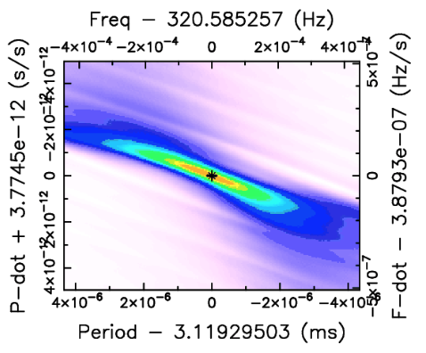
Using DART for Pulsars
Vigilant to control telescope (e.g., point, turn on/off, testing, etc.)
Stellarium for pulsar coordinates
Presto (Pulsar Exploration and Search Toolkit, by Scott Ransom) for data collection and analysis
My Collected Data
Data with a Pulsar
Pulsar data from: https://www.cv.nrao.edu/~sransom/presto/

Slide 5
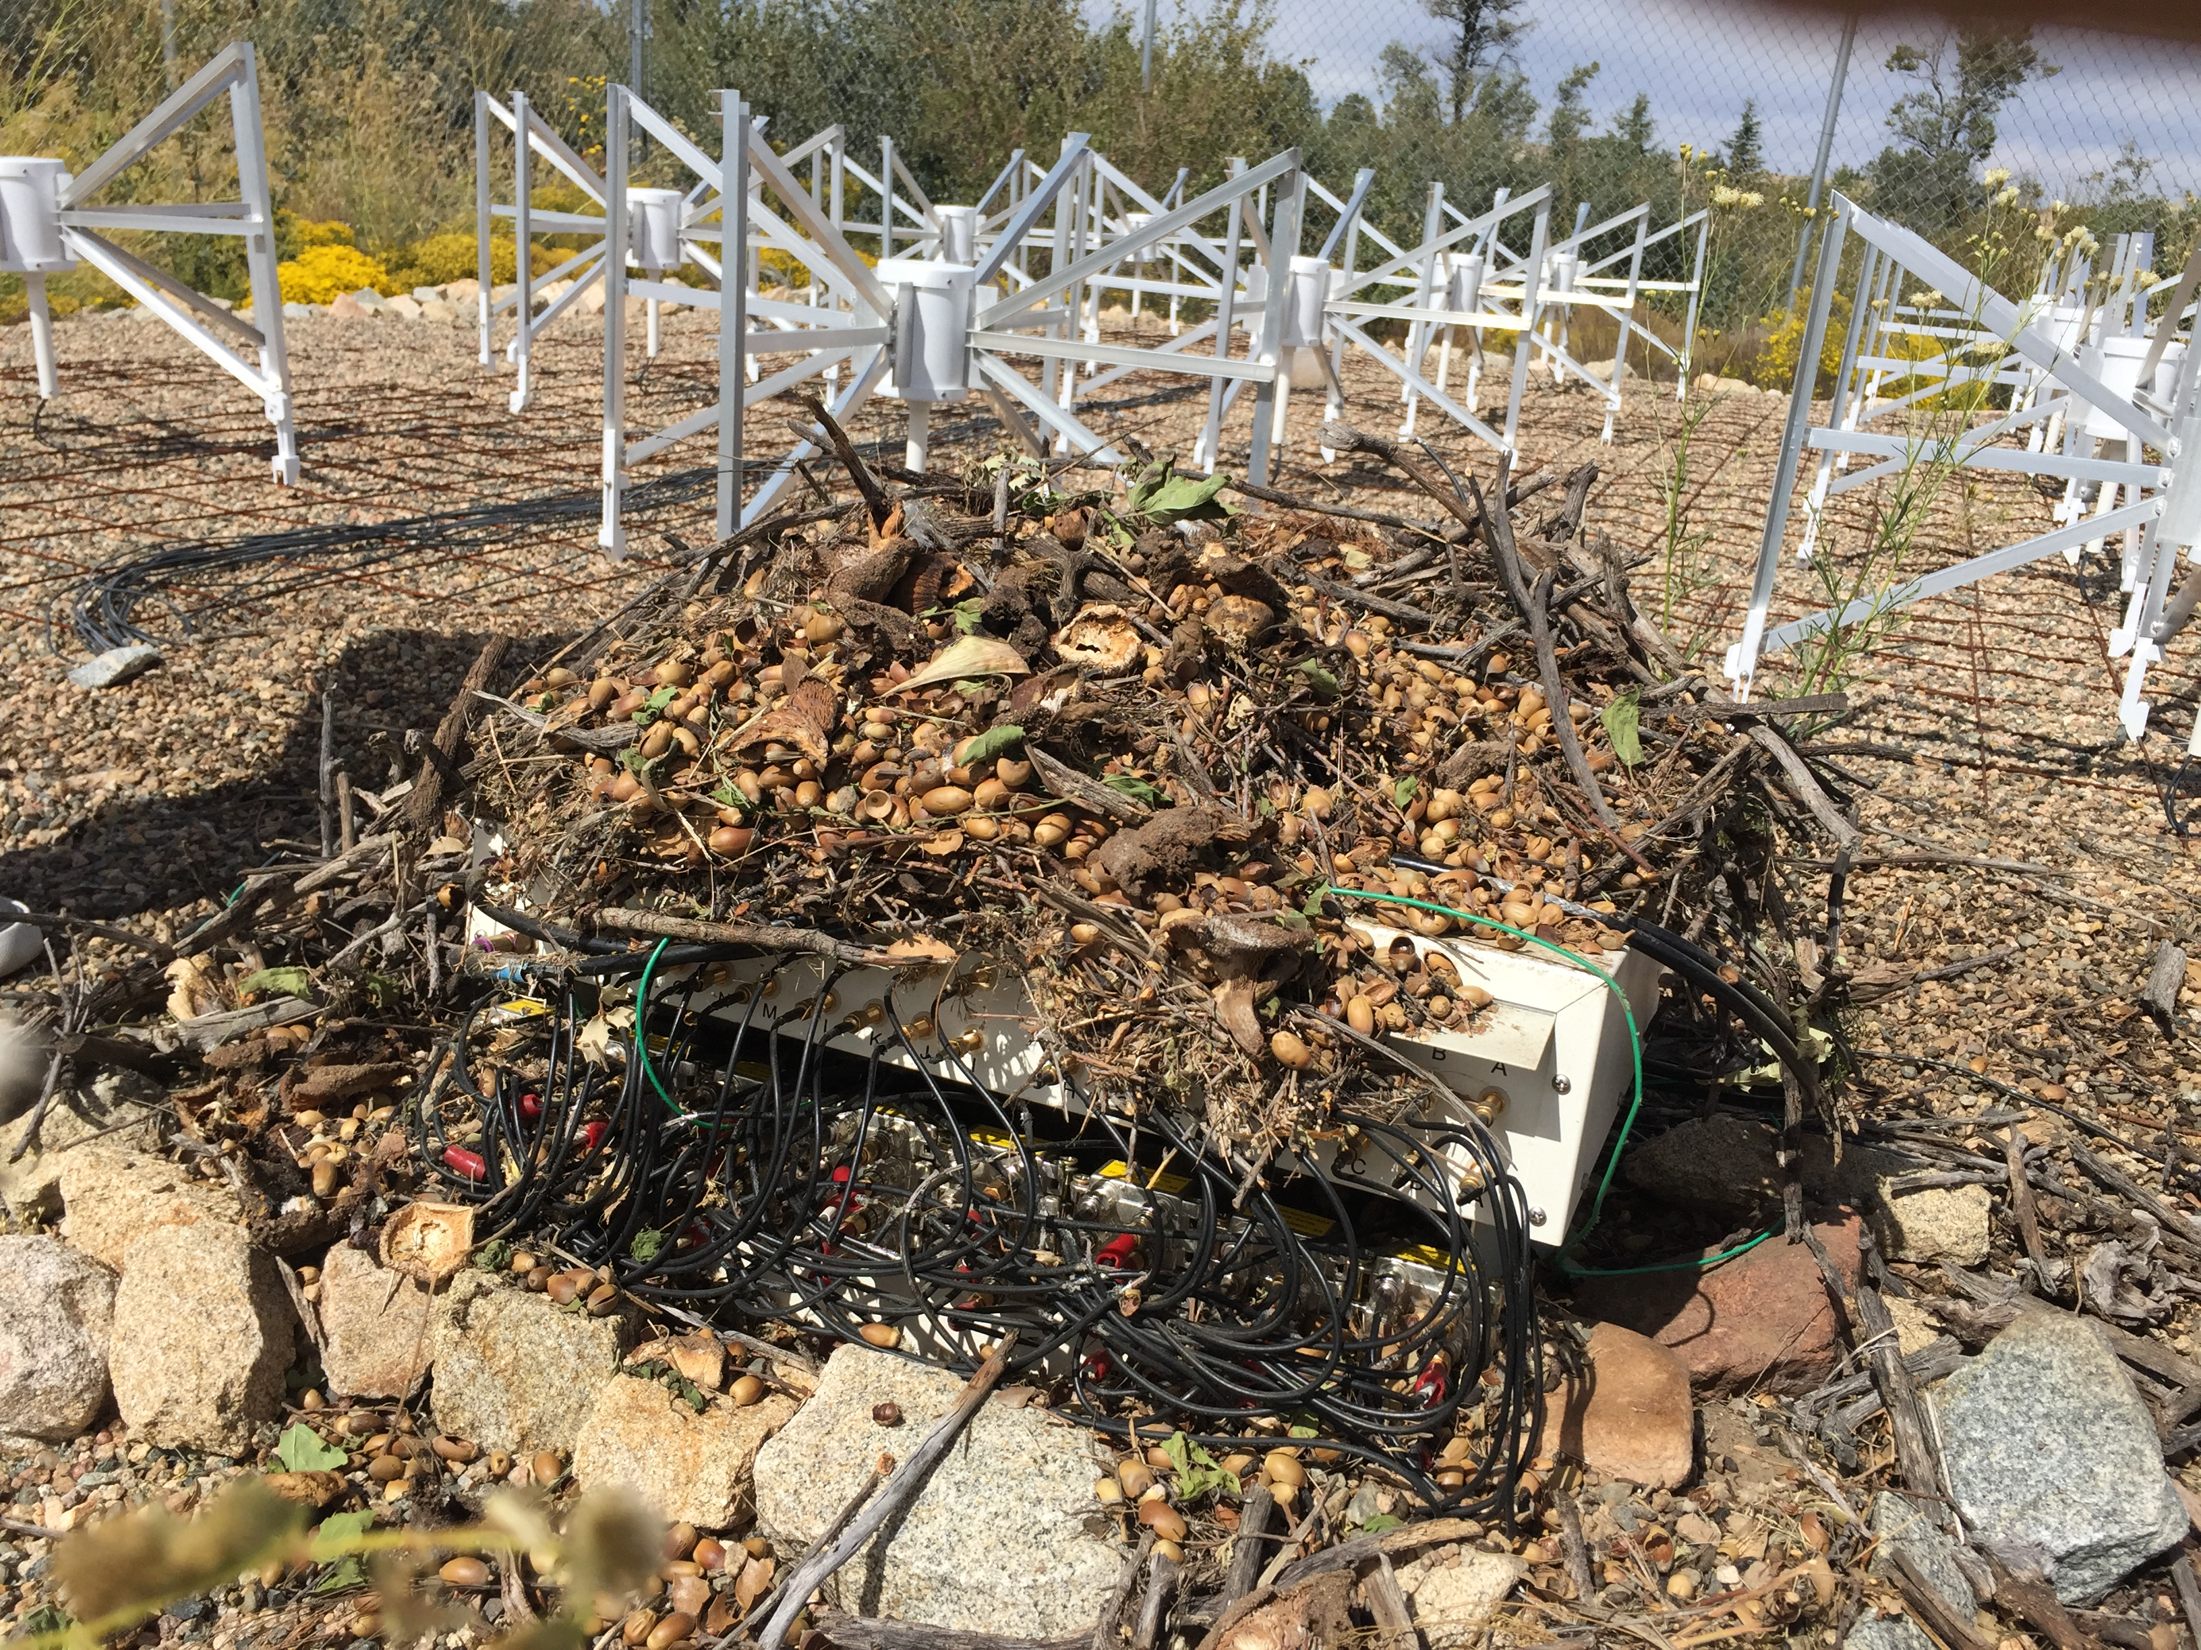
Issues Along the Way
Pests
  Chewed up cables
  Burnt inductors
Fried Circuit
  Burnt Arduinos
  Burnt circuit components

Slide 6
Accomplishments and Future Plans
Accomplishments
  Getting all tiles functional
  Synchronizing the tiles
  Detecting the sun
Future Plans
  Pulsar Detection
  Detecting pulsars with other telescopes
  Expanding the Radio Observatory

Slide 7
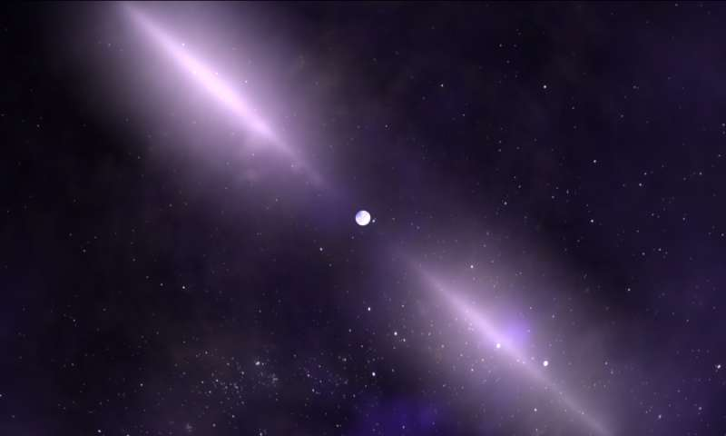
Questions?
Brittany Wright
Image Source: https://phys.org/news/2017-08-nasa-pulsars-years-chance-discovery.html

Slide 8
References
Skelly, Clare. NASA continues to study pulsars, 50 years after their chance discovery. NASA’s Goddard Space Flight Center. https://phys.org/news/2017-08-nasa-pulsars-years-chance-discovery.html
PRESTO Home. https://www.cv.nrao.edu/~sransom/presto/
COSMOS - The SAO Encyclopedia of Astronomy. http://astronomy.swin.edu.au/cosmos/p/pulsar

